Slide 1

UEMS Rheumatology Section Web Page: Past, Present & Future
Dr Deepak Nagra
MD (Res), MRCP, DipMSK
University Hospitals Coventry & Warwickshire

Slide 2

Why have a functional website ?
Professionalism
Competition
Education & resources
There is no reputable medical society without a functional webpage

Slide 3

What do we have now ?

Slide 4
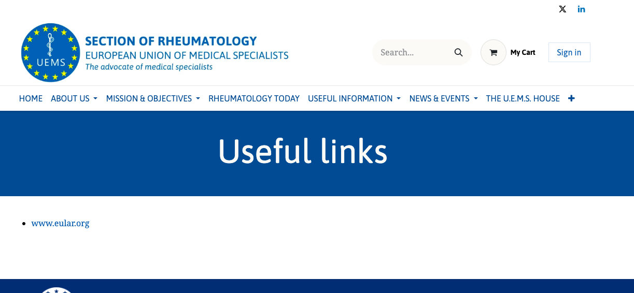
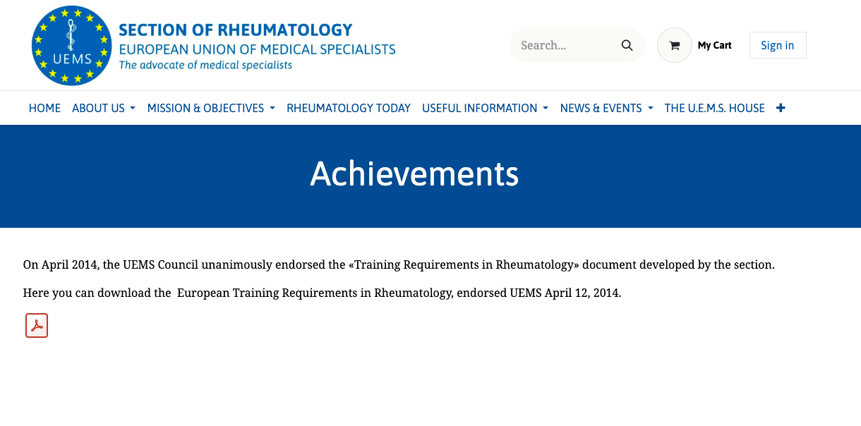
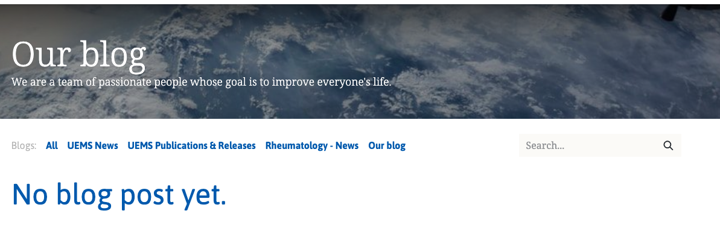
Is old really gold ?

Slide 5
The aim: Timeline
Begin critical analysis and revamp plan for the website May 2026
Prototype last quarter 2026
Expected by May 2027, new updated website which is live

Slide 6
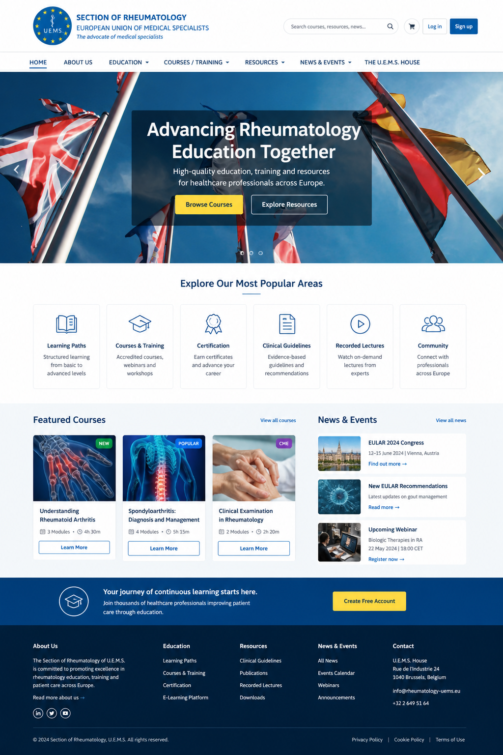
Current ideas and thoughts

Slide 7


Slide 8
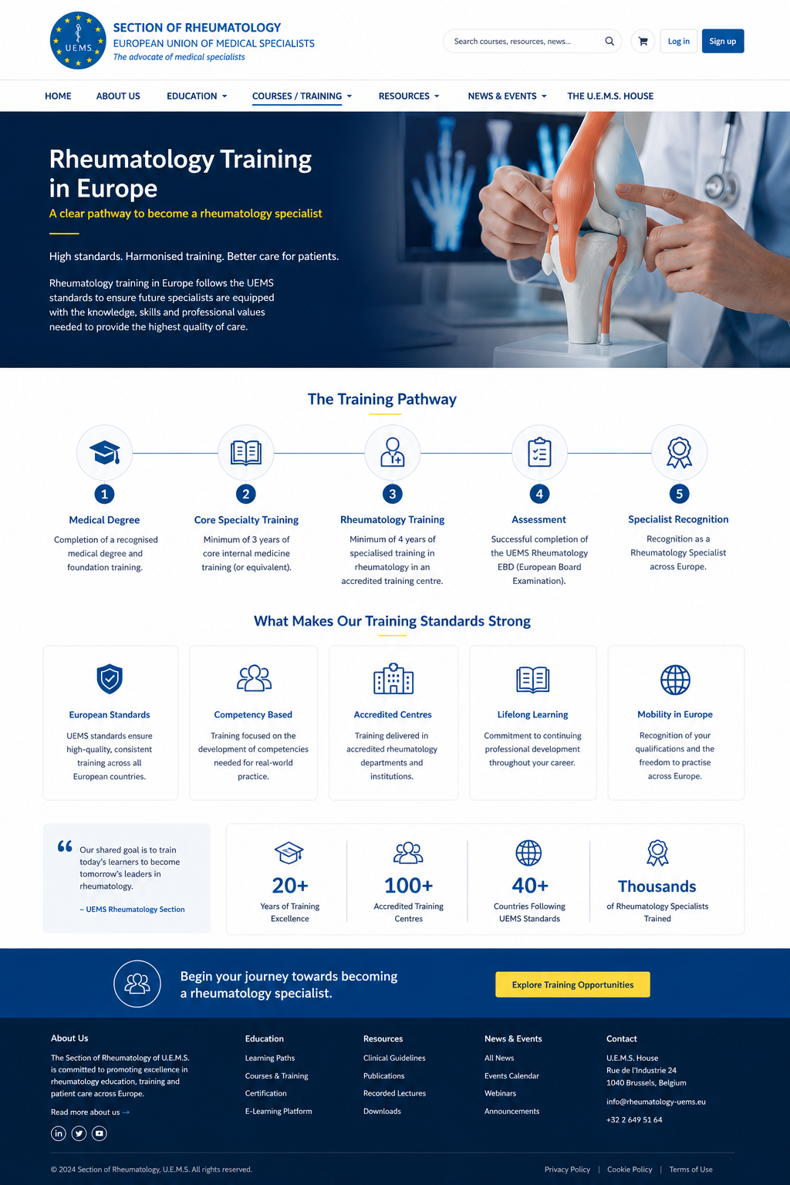

Slide 9
Summary
Not changing website drastically
Smaller functional changes and adaptations to make it useful and user friendly and increase traffic !
Need to keep it updated regularly

