Slide 1

UEMS · ETR · 2026
The 2026 European Training Requirements in Rheumatology
Prof. Miroslav Mayer
UEMS Section of Rheumatology — Members' Meeting
Prague · May 2026
ETR Working Group

Slide 2
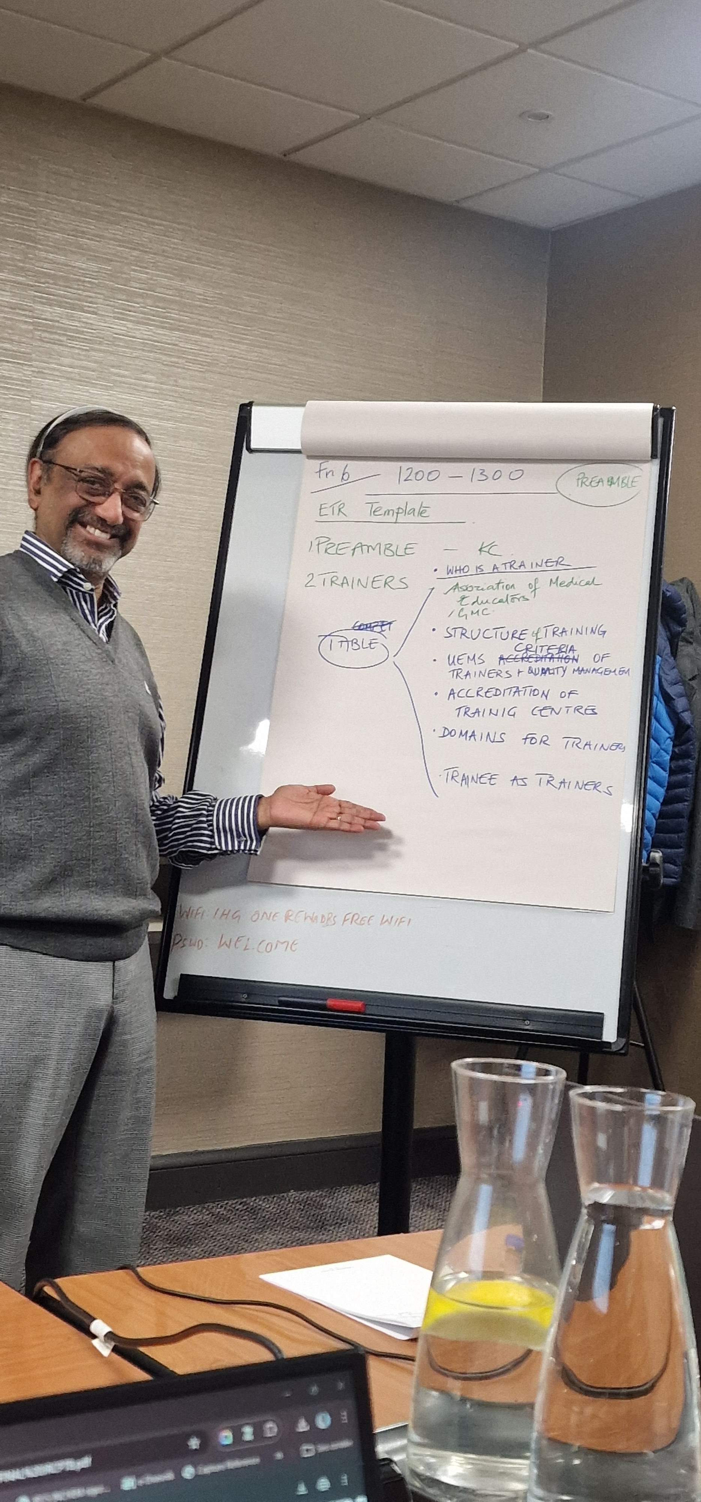

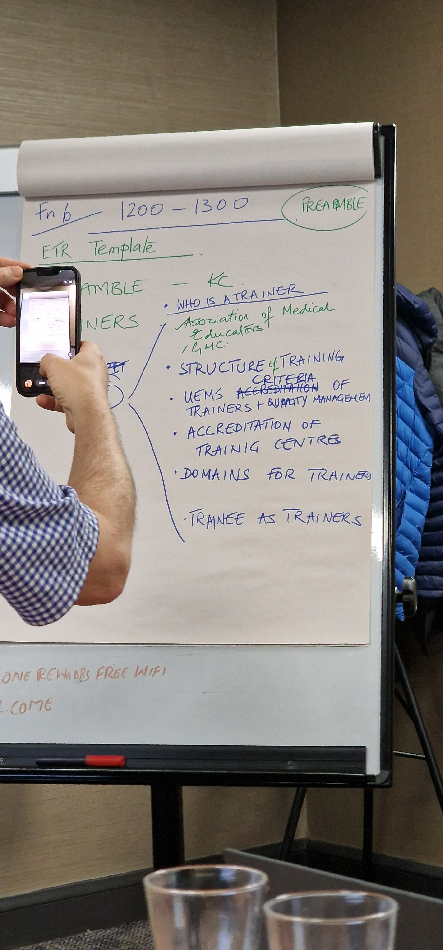
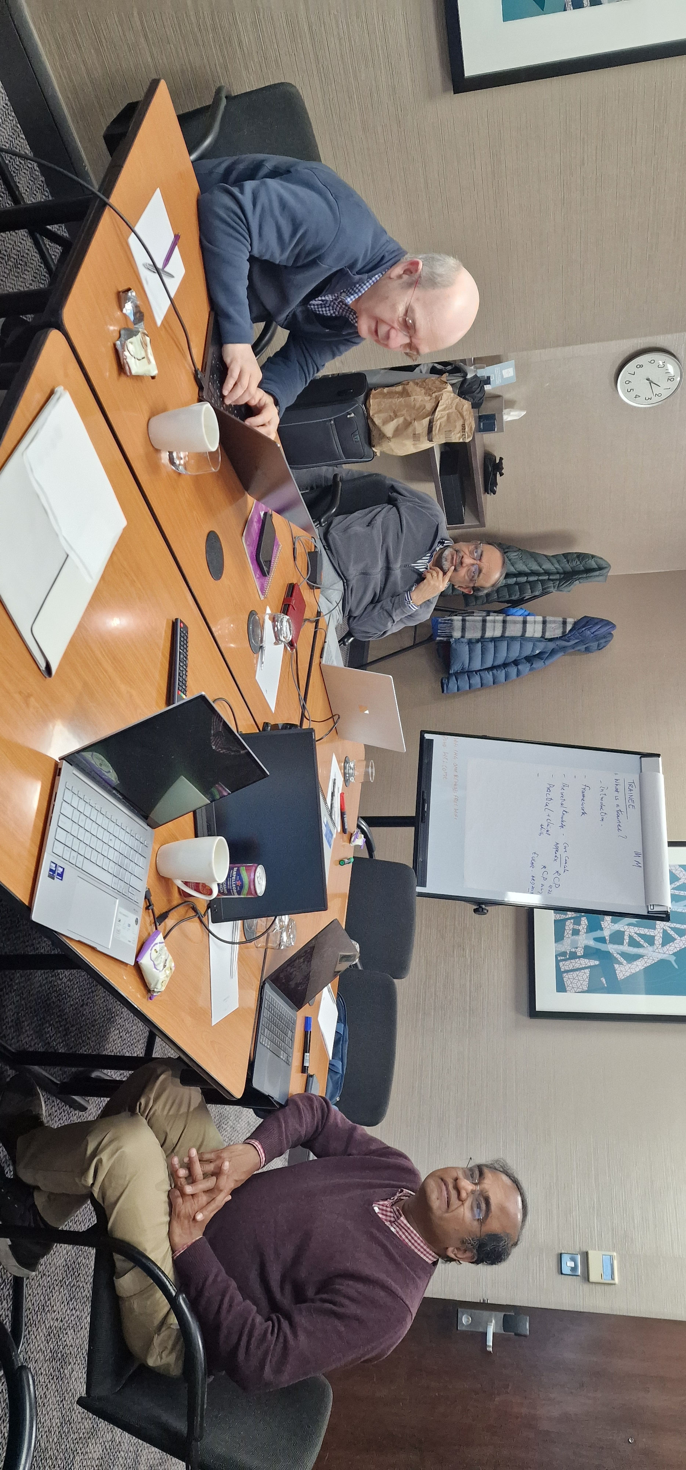
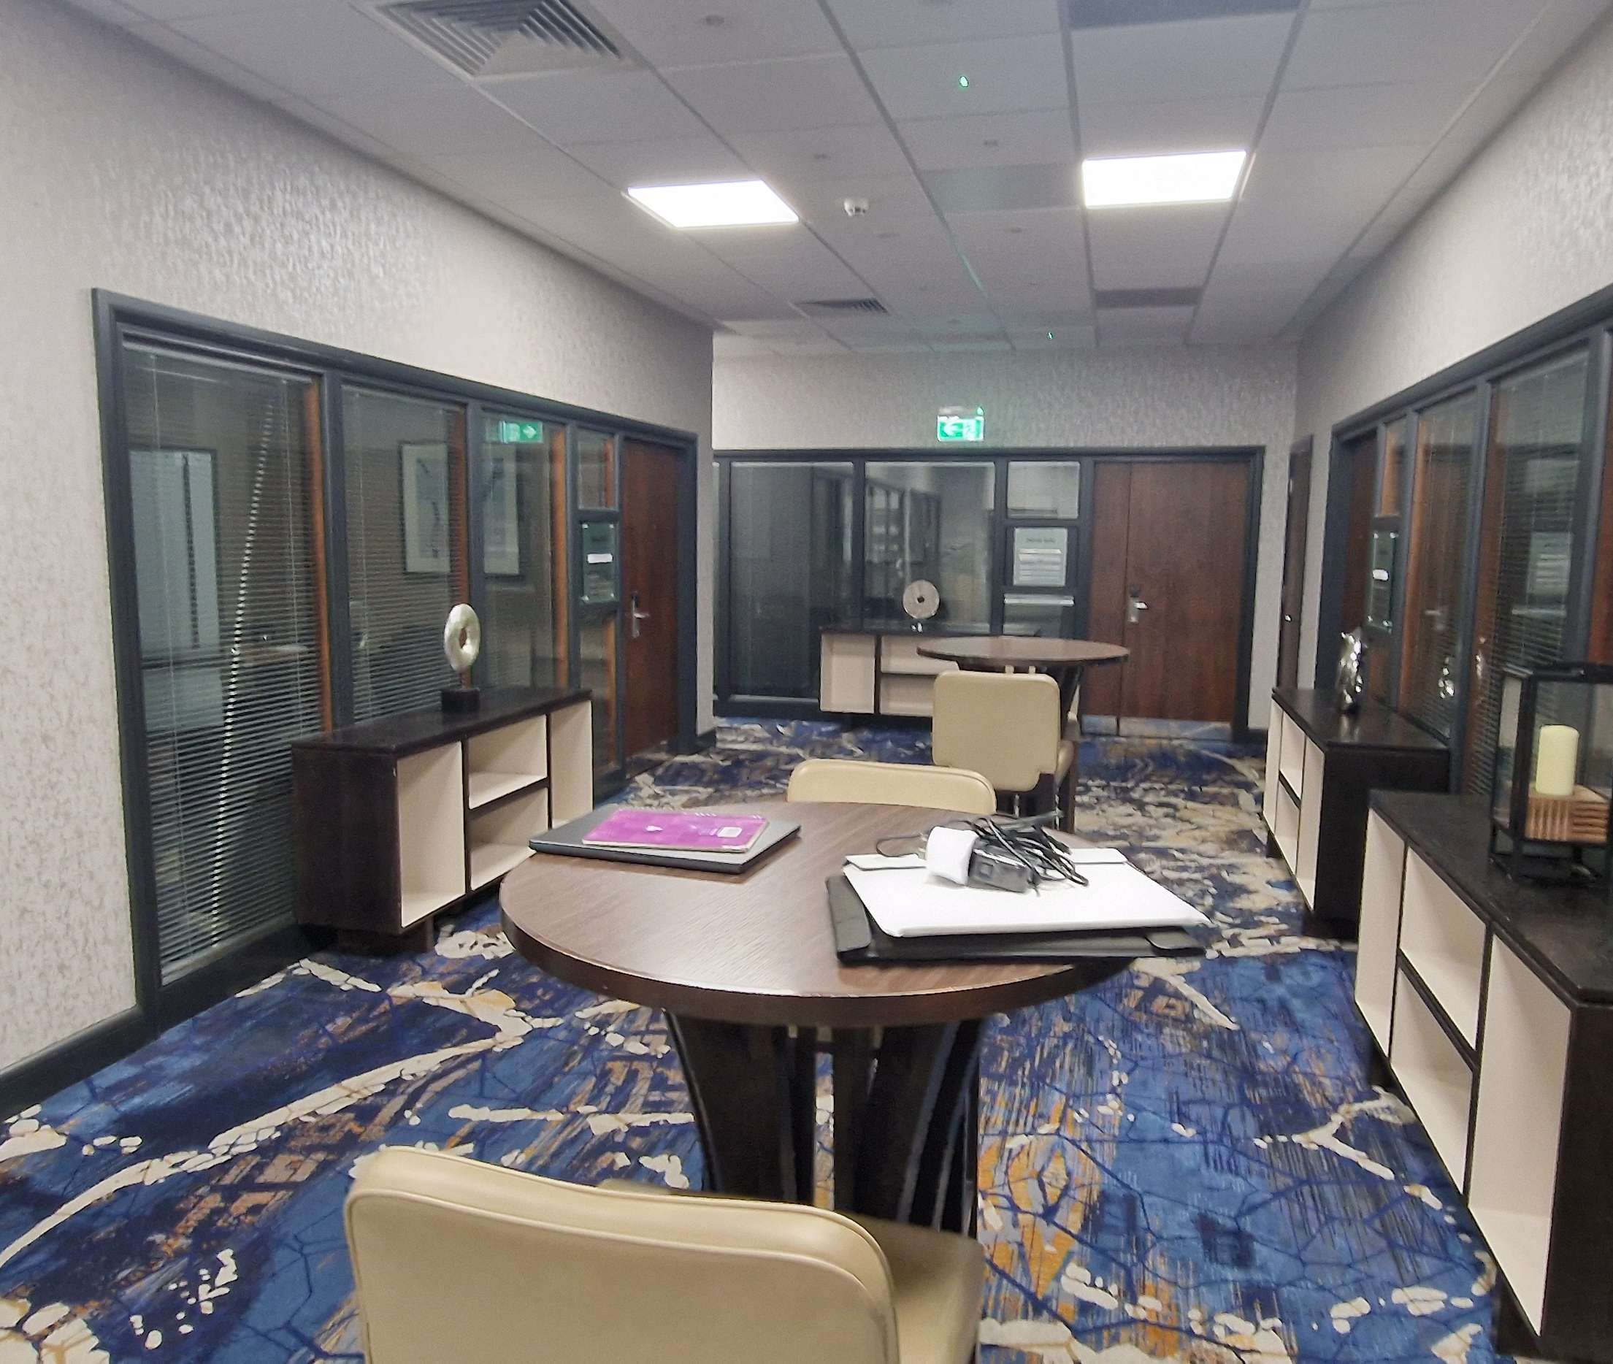

Slide 3
WHAT CHANGED
3
From 2014.21 to 2026 — a different document
/ 22
UEMS 2014.21 · the previous ETR
UEMS 2026 · the new ETR
Knowledge-and-skills syllabus model
Topic-based curriculum, no EPAs
Limited assessment guidance
Trainer requirements briefly stated
Quality assurance largely deferred to NMCAs
No transitional-care framework
Inclusivity not addressed
Competency-based architecture (CBME)
11 EPAs as the primary instrument of assessment
EULAR–UEMS 7 domains × CanMEDS 7 roles, fully mapped
Part II — trainer roles (4) and competencies (7 domains)
Part IV — full quality assurance framework
Transitional care embedded (Part I §1.1.5 + EPA 7)
Inclusivity appendix grounded in UEMS 2024.13
UEMS Section of Rheumatology · Prague 2026
ETR Rheumatology 2026

Slide 4
FRAMEWORK
4
Built to the UEMS 2025 template
/ 22
The 2026 ETR follows the UEMS 2025 ETR template (UEMS 2025.07 Terms of Reference) and is anchored in the UEMS Charter family.
Underpinning UEMS source documents
Charter on Specialist Training
1993, rev. 2007
Four-Part structure
  Part I — Trainee · Part II — Trainer · Part III — Training Institution · Part IV — Quality and Quality Enhancement
Five Appendices + new Appendix 6
  Conditions list · Logbook · EPA descriptions · Supporting trainees · EPA × Knowledge matrix · Inclusivity
Pan-European compatibility
  UK-specific terms (ARCP, CCT, GPC, ACAT, QIPAT) replaced with NMCA-level equivalents
Five-yearly revision cycle
  Per UEMS 2025.07 ToR — built into Part IV §7.3
Charter on Quality Assurance
1996
Charter on Visitation of Training Centres
1997
Basel Declaration / CPD Charter
2001 / 2024
Promoting Good Medical Care
2004
UEMS 2006/19 — Assessment Policy
2006
UEMS 2024.13 — Quality Indicators
2024
UEMS 2025.07 — ETR Terms of Reference
2025
UEMS Section of Rheumatology · Prague 2026
ETR Rheumatology 2026

Slide 5
EULAR – UEMS COOPERATION
5
Education aligned across the two pillars of European rheumatology
/ 22
Two organisations, one pan-European training architecture — increasingly converged through joint standards and shared infrastructure.
EULAR · the academic pillar
Joint EULAR – UEMS standards
UEMS · the regulatory pillar
Standards · Recommendations · Schools
The 2023 reference document
ETRs · Charters · Quality indicators
EULAR School of Rheumatology
EULAR Online Course
EULAR portfolio (van Onna 2021)
EULAR clinical recommendations (RA · SLE · vasculitis · transition · pregnancy)
PARE — patient organisations
Alunno et al. ARD 2023; 82(8):1107–13
Seven competency domains
28 named competencies
Adopted as the European reference
Anchors EULAR examination & UEMS ETR
UEMS Section of Rheumatology
European Board of Rheumatology
ETR 2014.21 → ETR 2026
Quality indicators (UEMS 2024.13)
Cross-border recognition (Dir. 2005/36/EC)
UEMS Section of Rheumatology · Prague 2026
ETR Rheumatology 2026

Slide 6
EVIDENCE BASE
6
The publications that shaped the new ETR
/ 22
FRAMEWORK
EPA THEORY
CanMEDS 2015
Ten Cate 2005 / 2016 · AMEE Guide 99 (2015)
Frank, Snell, Sherbino — Royal College of Physicians and Surgeons of Canada
Med Educ 39 · Acad Med 91 · Med Teach 37
Defines the seven physician roles. Adopted as the cross-cutting role architecture in Part I §1.2.
Gives us EPAs and the supervision-level (entrustment) scale. Anchors Appendix 3 and the EPA × Knowledge matrix.
EUROPEAN STANDARD
ASSESSMENT
EULAR–UEMS standards (2023)
EULAR PtC on assessment (2019)
Alunno et al. Ann Rheum Dis 2023; 82(8):1107–1113
Sivera et al. Ann Rheum Dis 2021; 80(1):65–70
The seven domains, 28 competencies. The European reference standard for our content scope.
Defines the workplace-based assessment toolkit (mini-CEX, DOPS, CbD, MSF, PS) used in Part I §2.4.
PORTFOLIO
ASSESSMENT EVIDENCE
EULAR Portfolio for Rheumatology training (2021)
Strategies for competence assessment (2020)
van Onna et al. RMD Open 2021; 7(2):e001684
Najm et al. RMD Open 2020; 6(2):e001183
Concrete portfolio model — anchors Part I §2.4 and the trainee progression process.
Qualitative evidence on what works in European rheumatology assessment — informs Part I §2.4 design.
GLOBAL STANDARD
TRANSITION
WFME Global Standards for PGME — 2023 Revision
EULAR/PReS transitional care recommendations (2017)
World Federation for Medical Education
Foster et al. Ann Rheum Dis 2017; 76(4):639–646
The global quality benchmark. Anchors Part IV (Quality Assurance and Quality Enhancement).
The basis of EPA 7 and the structural commitment to transitional care in Part I §1.1.5.
UEMS Section of Rheumatology · Prague 2026
ETR Rheumatology 2026

Slide 7







CANMEDS 2015
7
Seven roles, one rheumatologist
/ 22
Medical Expert
Communicator
Collaborator
Leader
Health Advocate
Scholar
Professional
Diagnosis, management, evidence-based care of RMDs (central role)
Patient · family · MDT — across long-term care
MDT-based and shared-care practice; primary-care interface
Service organisation, resource stewardship, patient pathways
Determinants of health · access · vulnerable groups
EBM, teaching, research, lifelong learning, AI/digital literacy
Ethics · self-regulation · personal health · accountability
Each EPA in Appendix 3 is mapped to its primary CanMEDS roles. The Medical Expert role is the integrating role and never appears alone.
How CanMEDS sits next to EULAR–UEMS Domains → CanMEDS describes the WHO (the physician); EULAR–UEMS Domains describe the WHAT (the content of rheumatology). Both axes are honoured in every EPA description.
UEMS Section of Rheumatology · Prague 2026
ETR Rheumatology 2026

Slide 8
ENTRUSTABLE PROFESSIONAL ACTIVITIES
8
EPAs — the operational core of the new ETR
/ 22
An EPA is a unit of professional practice that a competent supervisor can entrust to a trainee at a defined level of supervision. Eleven EPAs span the European rheumatologist's role at completion of training.
EPA 1 — New inflammatory arthritis
EPA 2 — Long-term chronic RMD care
EPA 3 — Rheumatological emergency
EPA 4 — Diagnostic / therapeutic procedures
EPA 5 — Complex immunomodulatory therapy
EPA 6 — Rheumatology consultation
EPA 7 — Paediatric–adult transitional care
EPA 8 — Lead a multidisciplinary team meeting
EPA 9 — Critical appraisal of evidence
EPA 10 — Patient safety / quality improvement
EPA 11 — Patient & family communication
Each EPA carries a supervision-level target L1 observe · L2 act under direct supervision · L3 act under indirect supervision · L4 act unsupervised. Most EPAs target Level 4 by completion.
UEMS Section of Rheumatology · Prague 2026
ETR Rheumatology 2026

Slide 9
ANATOMY OF AN EPA
9
Worked example — EPA 5: complex immunomodulatory therapy
/ 22
Initiate, monitor, and adjust complex immunomodulatory therapy in patients with RMDs
Target: Level 4
Knowledge
Skills
DMARDs, biologics, JAK inhibitors · pharmacology · vaccination · infection screening · pregnancy compatibility · peri-operative use
Drug selection · safety monitoring per EULAR recommendations · dose adjustment · response assessment · interdisciplinary liaison
Attitudes
Assessment
Shared decision-making · risk communication · patient autonomy · transparency about uncertainty · response to adverse events
mini-CEX (clinic) · CbD (case) · DOPS (procedures) · MSF · drug-prescribing logbook · annual progression review
CanMEDS roles · EULAR–UEMS Domains
Medical Expert (primary) · Communicator · Health Advocate · Professional · D1 Knowledge · D2 Skills · D4 Communication · D5 Ethics
Same template applies to every EPA in Appendix 3 — five fields, predictable structure, easy to assess against.
UEMS Section of Rheumatology · Prague 2026
ETR Rheumatology 2026

Slide 10
EPAs ↔ CIPS
10
Same idea, different vocabulary
/ 22
EPAs (UEMS, USA, NL) and Capabilities in Practice (CiPs — UK) are two operational forms of the same underlying construct: a unit of practice for which a global entrustment judgement can be made.
EPA · UEMS / NL / US
CiP · UK (JRCPTB 2022)
Origin
Ten Cate (2005, 2015 AMEE 99)
Shape of Training (UK, 2013)
Number
11 in this ETR
21 (6 generic + 8 IM + 7 specialty)
Mapping axis
CanMEDS roles + EULAR–UEMS domains
GMC Generic Professional Capabilities
Supervision
L1–L4 (this ETR)
L1–L4 (identical scale)
Year-by-year
Single end-target (Part I §1.3)
Explicit ST4–ST7 grid (JRCPTB Tables 1–2)
Procedure mins
Logbook listed; numbers optional
Year-specific (knee/shoulder ST4 etc.)
Assessment
WBA toolkit per EULAR PtC 2019
WBA + SCE + ARCP decision aid
UEMS Section of Rheumatology · Prague 2026
ETR Rheumatology 2026

Slide 11
WHAT THE UK MODEL TAUGHT US
11
JRCPTB 2010 → 2022 — 12 years of CBME at scale
/ 22
The UK has run a CBME-based rheumatology curriculum since 2010 and revised it twice (2016, 2022). It is the most mature European-language CBME curriculum we have. We adopted what worked and avoided what didn't.
Adopted from JRCPTB
Adapted for European use
Four-level entrustment scale (L1–L4)
Workplace-based assessment toolkit
Educational Supervisor with full annual report
Mandatory MDT involvement
Transitional-care competence as a tracked element
Quality assurance via annual progression review
EPAs over CiPs — better-known internationally
EULAR–UEMS Domains, not GMC GPCs
CanMEDS over UK 'GPC framework'
Pan-European terminology (NMCA, not deanery)
Replaced ARCP/CCT/QIPAT etc. with neutral terms
Five-yearly UEMS revision cycle, not annual GMC
Caveat: JRCPTB has year-by-year supervision-level grids that we still lack. See slide 19.
UEMS Section of Rheumatology · Prague 2026
ETR Rheumatology 2026

Slide 12
COMPETENCY-BASED MEDICAL EDUCATION
12
CBME is a philosophy of training, not a checklist
/ 22
Outcome-based
Progressive entrustment
Training is defined by what the trainee can DO at completion — not by years served.
Trainees move through levels of supervision as competence is demonstrated, not on a clock.
Workplace-based assessment
Programmatic assessment
Many short observations across many encounters — not one high-stakes summative judgement.
No single tool decides; a portfolio of evidence informs a triangulated annual decision.
What this means in practice Trainees with a portfolio of WBAs across the eleven EPAs, an Educational Supervisor's report, and a triangulated annual review of progression. Time-in-post is necessary but not sufficient.
UEMS Section of Rheumatology · Prague 2026
ETR Rheumatology 2026

Slide 13
DESIGN PRINCIPLE
13
Strong frame, national flexibility
/ 22
European specialist training is not, and should not be, uniform. The ETR sets the European-level standard; National Medical Competent Authorities (NMCAs) implement it within national frameworks.
What the ETR fixes (the FRAME)
What stays national (FLEXIBILITY)
Curriculum content (Appendix 1)
Required: 11 knowledge sections including all autoinflammatory, paediatric/transition, rare diseases
Depth and order of teaching set nationally
Assessment philosophy
WBA + portfolio + annual progression review
Specific tools, naming, regulatory body chosen nationally
Duration
Minimum core rheumatology of 4 years (Part I §2.1)
Total programme length and IM exposure set nationally
Trainer competence
Trainer roles and 7-domain competency framework
Recognition mechanism and nomenclature national
Quality assurance
QA principles per UEMS Charters and WFME standards
National accreditation systems retained
Cross-border recognition
Aligned with Directive 2005/36/EC + 2013/55/EU
National implementation of automatic recognition
UEMS Section of Rheumatology · Prague 2026
ETR Rheumatology 2026

Slide 14



PART II — THE TRAINER
14
Four roles, seven competency domains
/ 22
Teacher
Mentor
Clinical Supervisor
Educational Supervisor
Delivers structured teaching, scaffolds learning, models clinical reasoning.
Supports professional and personal development; provides career guidance.
Direct/indirect clinical supervision; ensures safety and progressive autonomy.
Owns the educational agreement; integrates evidence; signs off progression.
Seven domains of trainer competence (Part II §4)
1 Educational philosophy
2 Curriculum & teaching
3 Learning environment
4 Mentorship & support
5 Assessment
6 Feedback & remediation
7 Self-development
Trainer recognition by NMCAs is built on documented competence in these domains, periodic CPD, and trainee feedback.
UEMS Section of Rheumatology · Prague 2026
ETR Rheumatology 2026

Slide 15
PART IV — QUALITY ASSURANCE
15
Three layers, one closed loop
/ 22
Anchored in:
Layer 1 — Internal QA
UEMS Charter on QA in Specialist Practice (1996)
UEMS Charter on Visitation of Training Centres (1997)
UEMS Promoting Good Medical Care (2004)
UEMS 2006/19 Assessment Policy
UEMS 2024.13 Quality Indicators
WFME Global Standards 2023
Directive 2011/24/EU (cross-border care)
Annual quality report · trainee feedback · WBA outcomes · trainer evaluation · safety incidents (Part IV §2)
Layer 2 — National accreditation
Quality Enhancement
(Part V)
NMCA-led review of training centres · external reviewer · written report · corrective actions (Part IV §3)
Layer 3 — European-level visitation
Optional · UEMS Charter on Visitation (1997) · complementary, not replacing national process (Part IV §3.4)
Data protection (GDPR) explicitly addressed in Part IV §9 — most ETRs lack this.
UEMS Section of Rheumatology · Prague 2026
ETR Rheumatology 2026

Slide 16
TRANSITIONAL CARE
16
From paediatric to adult — now structurally embedded
/ 22
Why this matters
Where it lives in the 2026 ETR
Many young adults with juvenile-onset RMDs constitute a substantial part of an adult rheumatology caseload.
Loss to follow-up at transition is a recognised driver of poor outcomes — relapse, organ damage, mental-health distress.
The 2017 EULAR/PReS standards (Foster et al.) provide a clear evidence base — but adoption across European training programmes has been uneven.
PART I §1.1.5
Dedicated transitional-care section · joint paediatric–adult clinic exposure required during second half of training
EPA 7
Provide developmentally appropriate care to adolescents and young adults during transition (standalone EPA)
APPENDIX 1 §9
Knowledge-section on paediatric rheumatology and transitional care · conditions and assessment
COLLABORATOR ROLE
Joint working with paediatric rheumatology, adolescent medicine, and youth-friendly services
REFERENCE [19]
Foster HE et al. EULAR/PReS standards. Ann Rheum Dis 2017; 76(4):639–646
UEMS Section of Rheumatology · Prague 2026
ETR Rheumatology 2026

Slide 17



ALSO NEW IN THIS REVISION
17
Quality-of-document improvements
/ 22
Inclusivity (Appendix 6)
Reference list rebuilt
Grounded in UEMS 2024.13 Quality Indicator 13 + UEMS Code of Conduct + Charter on Specialist Training
32 references, all verified — 13 new sources covering UEMS Charters, GDPR, EULAR clinical recommendations
Citation anchors added
Conditions list expanded
Every UEMS Charter mentioned in Part IV is now numerically cited; transitional-care, MDT, COI, GDPR all anchored
New sections on autoinflammatory disease, RMDs in pregnancy, transitional care, rare/orphan diseases
EPA × Knowledge matrix (App. 5)
Trainer competence framework
Cross-references all 11 EPAs with the 11 knowledge sections — supports examination blueprinting
Four-role taxonomy (Teacher · Mentor · Clinical Supervisor · Educational Supervisor) with 7 domains
UEMS Section of Rheumatology · Prague 2026
ETR Rheumatology 2026

Slide 18
HONEST REVIEW · STRENGTHS
18
What is genuinely strong about this draft
/ 22
Competency architecture
Building on Alunno 2023 + CanMEDS overlay is the right move; among the most sophisticated cross-mappings in current UEMS portfolio.
Eleven well-constructed EPAs
Right number — broad enough to span practice, focused enough to be assessable. EPA 11 (communication) as standalone is a bold, defensible choice.
Trainer section (Part II)
Four-role taxonomy + seven-domain framework is the strongest single section — directly usable for trainer accreditation across countries.
Quality framework (Part IV)
Three-layer model + GDPR + visitation is more developed than most other UEMS ETRs — coherent, enforceable, and defensible.
Pan-European discipline
Successful translation of UK-specific terms (ARCP/CCT/QIPAT/GPC) to neutral, NMCA-compatible language throughout.
Transitional care visibility
Standalone EPA 7 + dedicated §1.1.5 + Appendix 1 §9 — gives the area structural status, not just a mention.
UEMS Section of Rheumatology · Prague 2026
ETR Rheumatology 2026

Slide 19
PROPOSALS
20
What we are considering…
/ 22
1
Year-by-year EPA supervision grid
2
Procedure minimums
Adopt a JRCPTB-style table: levels expected at end of Y2, Y3, Y4
Adopt year-specific competency milestones
3
Appendix 1 → matrix
4
Master architecture diagram
Migrate from a list to a clinical-area × presentations × conditions matrix. Add learning-outcome verbs per condition tier
One page showing how EPAs, CanMEDS roles, EULAR–UEMS Domains, and Knowledge sections cross-map
5
Inclusivity appendix — operationalise
6
Primary-care interface
Replace the principle-essay style with a JRCPTB style
One paragraph in Part III on shared-care drug monitoring and primary-care liaison
7
Patient educator role
8
Workforce framing paragraph
Make patient involvement structural in Part II (trainer cohort) and in EPA 11, not only a soft mention in Appendix 6
Brief 'Future of the specialty' framing — flexible training, parental leave — visible in Specialty section…
UEMS Section of Rheumatology · Prague 2026
ETR Rheumatology 2026

Slide 20
NEXT STEPS
21
Where we are, where we go
/ 22
MAY 2026
WIN 2026
Section meeting
UEMS Council
Today — discussion and feedback from Section members
UEMS Council adoption · publication as UEMS 2026/xx
JUN 2026
AUT 2026
2027+
Revision
ETR Review Committee
Implementation
Incorporate Section feedback · resolve placeholders · finalise Appendix 1 matrix
UEMS ETR Review Committee · scoring against template
Adoption by NMCAs · CESMA examination alignment · five-yearly revision cycle
UEMS Section of Rheumatology · Prague 2026
ETR Rheumatology 2026

Slide 21
DISCUSSION
Three questions for the Section
1.
Are the 11 EPAs the right ones — and are we missing anything the next five years will demand?
2.
Should the supervision grid be year-by-year (JRCPTB-style) or remain as a single end-of-training target?
3.
What are the deal-breakers for your NMCA — where do we soften the frame, and where can we hold it firm?
Thank you · questions and comments very welcome miro.mayer@gmail.com
UEMS Section of Rheumatology · Prague 2026

