Slide 1

Rheumatology
Trainees perspective
Dr Deepak Nagra
MD(res), MRCP, DipMSK
University Hospitals Coventry & Warwickshire

Slide 2
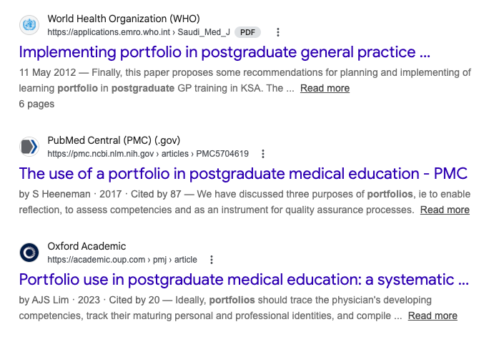
Why have a portfolio ?
Map educational plan
Monitor progress and objective set by assessor
Feedback & Reflection
Continuity / log of work in case of geographical displacement
Standardizes medical education and clinical practice

Slide 3
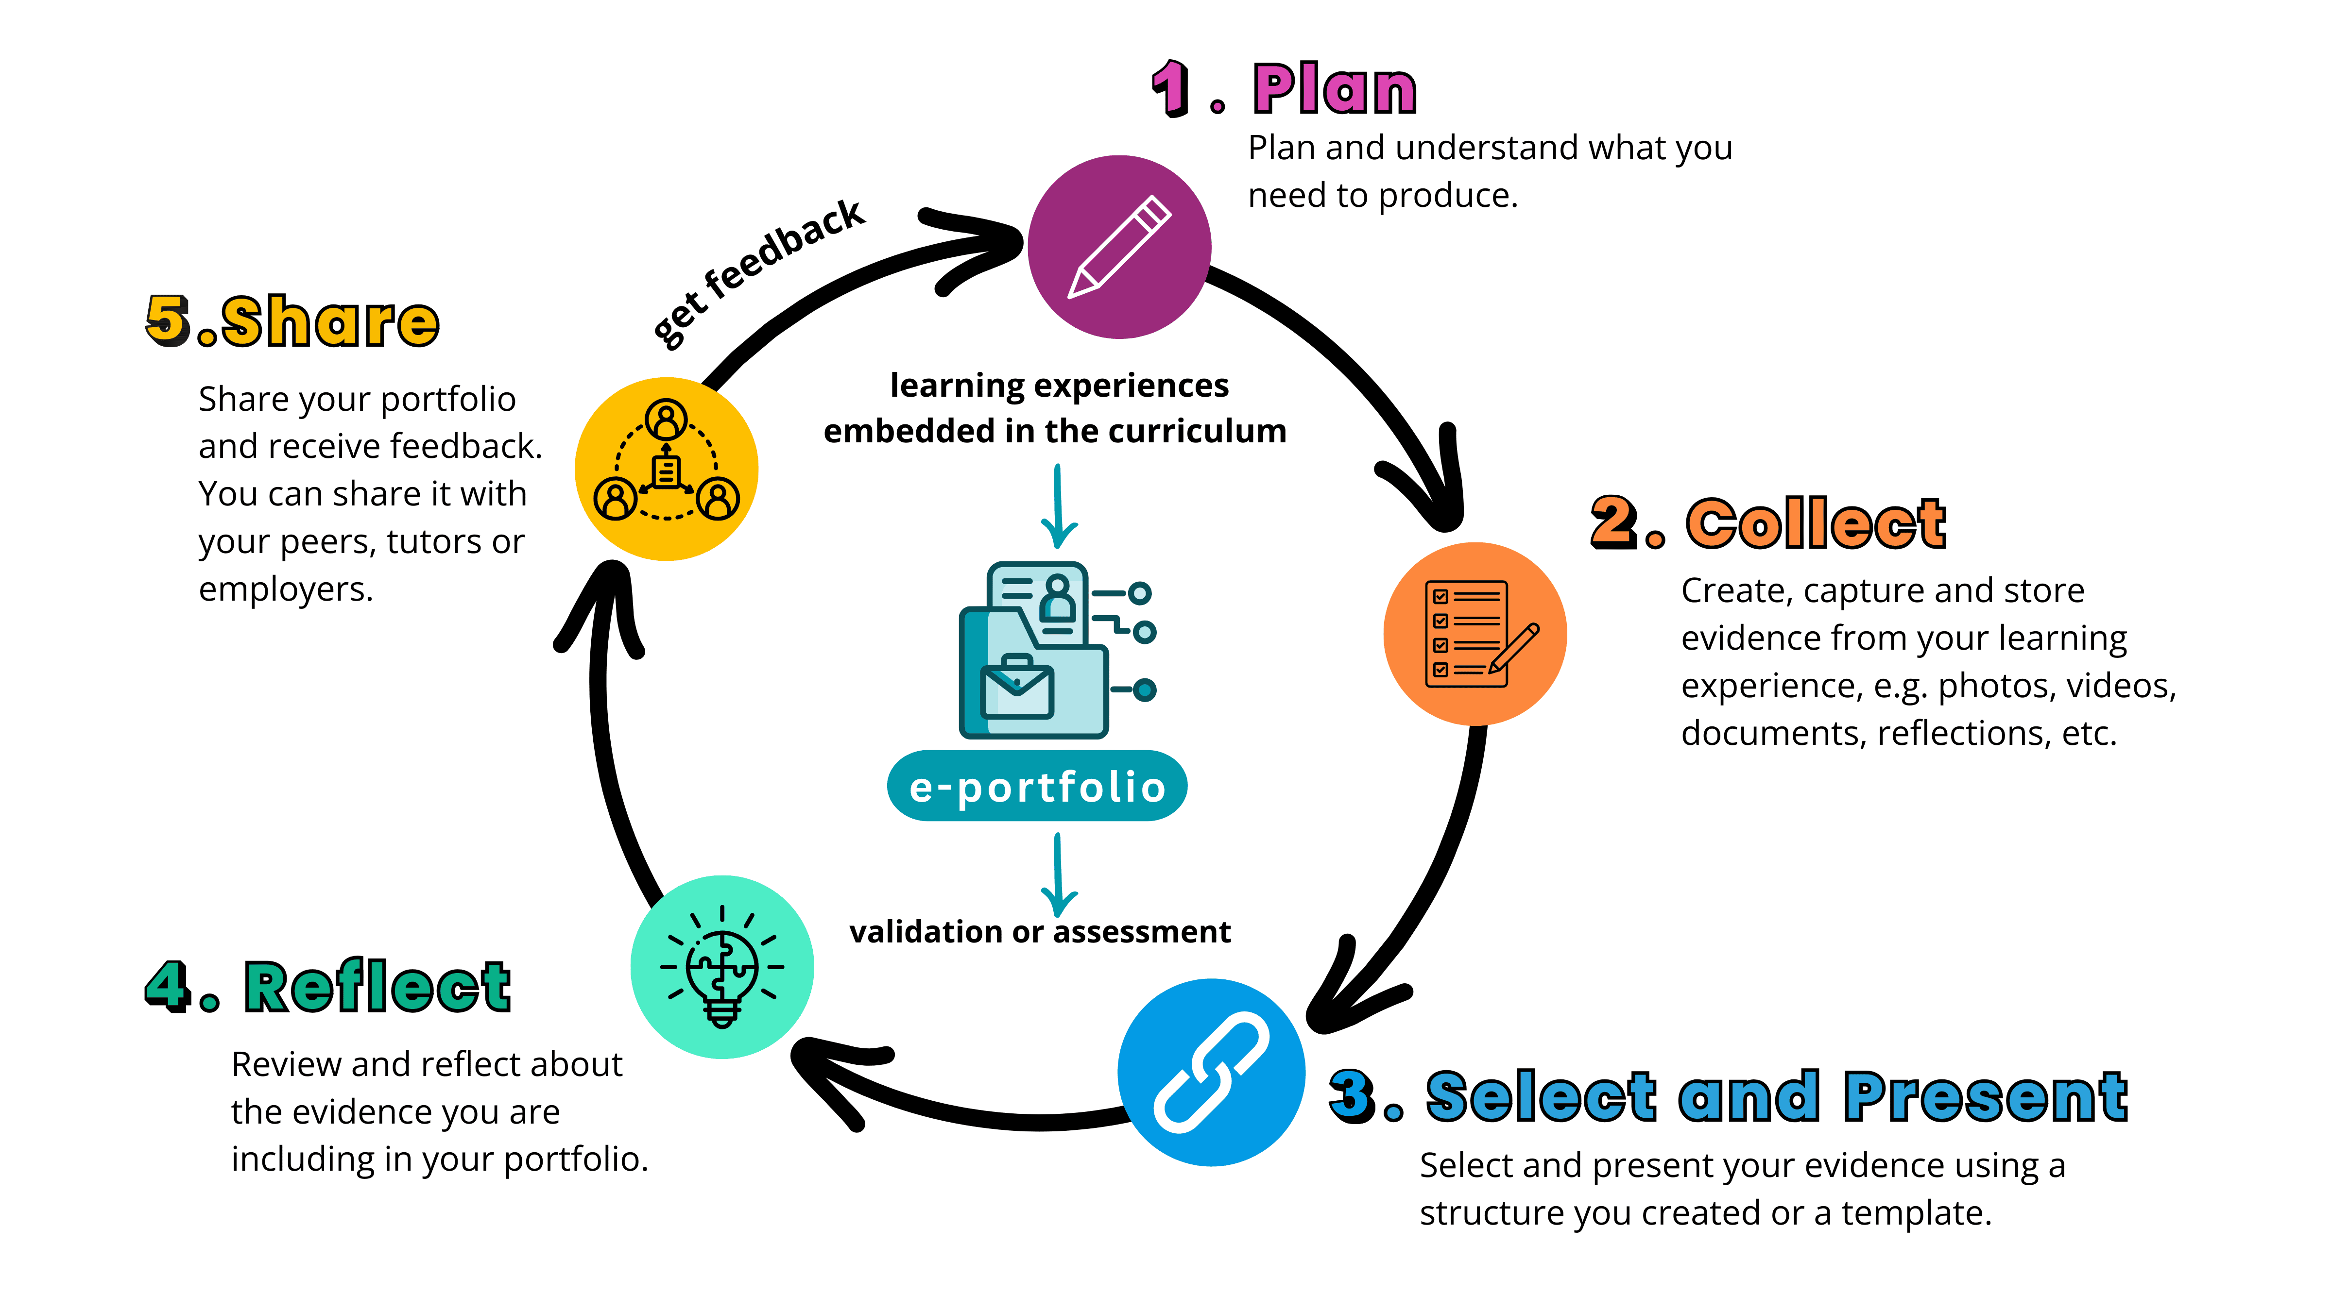
What is a portfolio ?
Compilation of work based assessments
Record of qualifications
Platform to record feedback

Slide 4
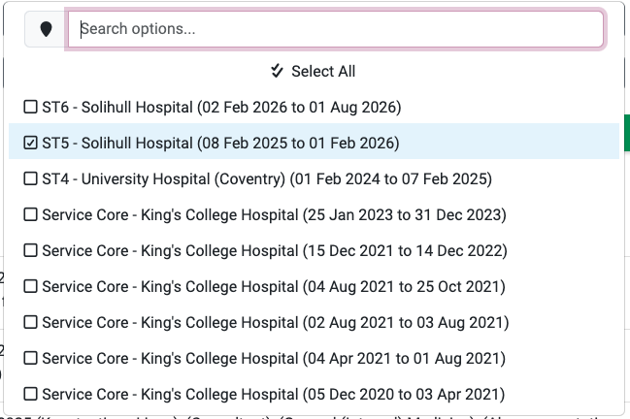
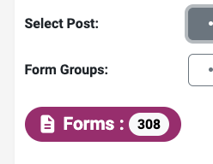
What can be produced ?

Slide 5
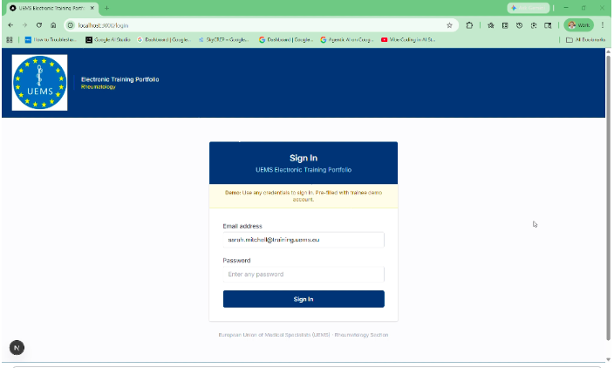
A Prototype in the making

