Slide 1

UEMS – RHEUMATOLOGY ANNUAL MEETING
MADRID. MAY 8TH – MAY 9TH

Slide 2

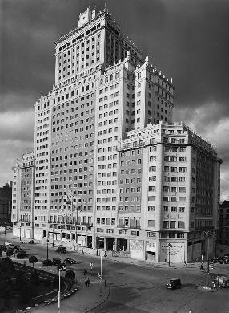
SITE EDIFICIO ESPAÑA - RIU HOTEL
Edificio España built between 1948 and 1953.
Designed by architects Julián and José María Otamendi, neoherrerian and art déco styles.
Standing at 117 meters with 26 floors, it was the tallest building in Spain upon its completion, symbolizing the nation's post-war modernization efforts

Slide 3
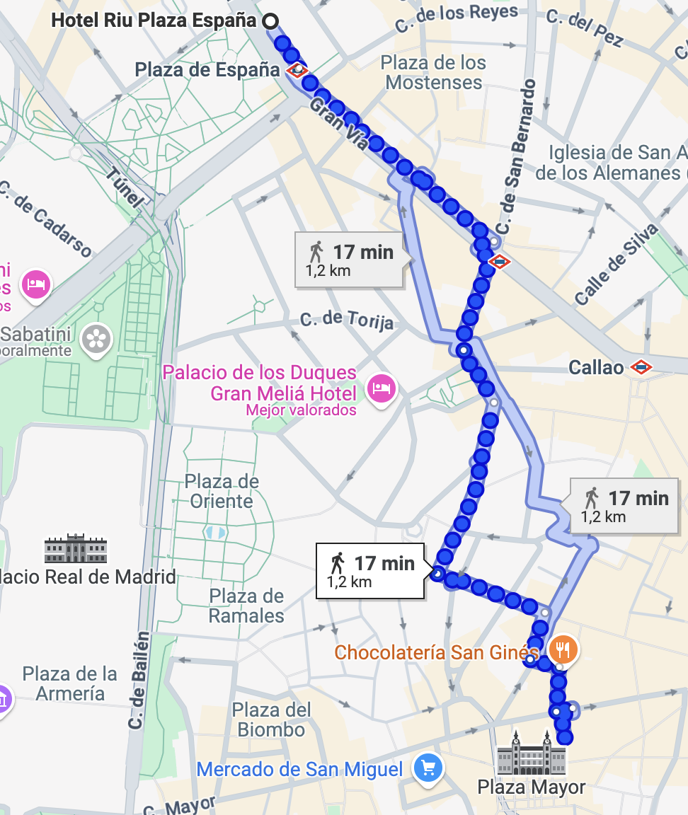

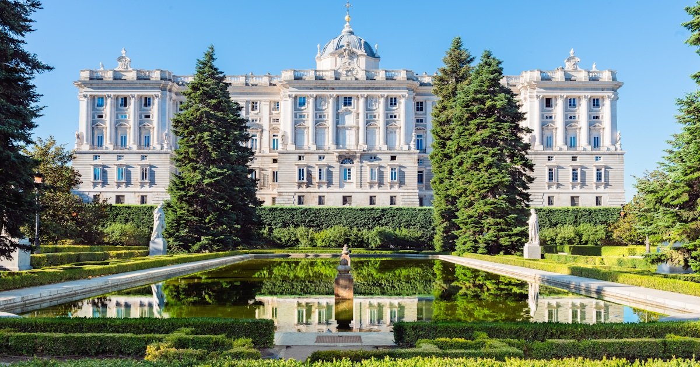
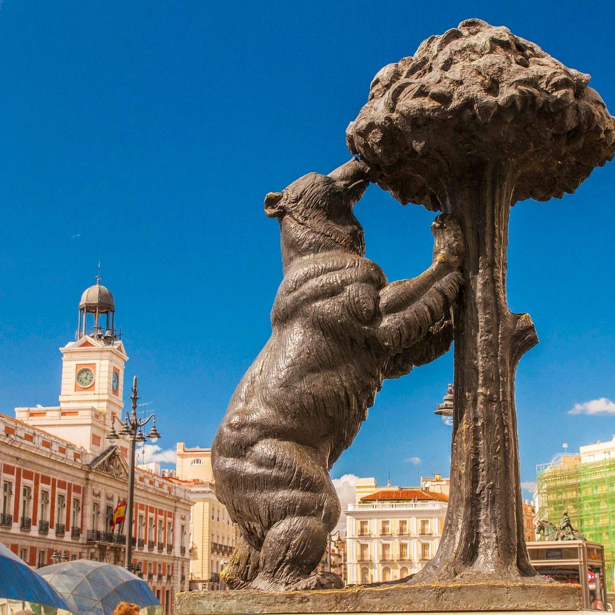
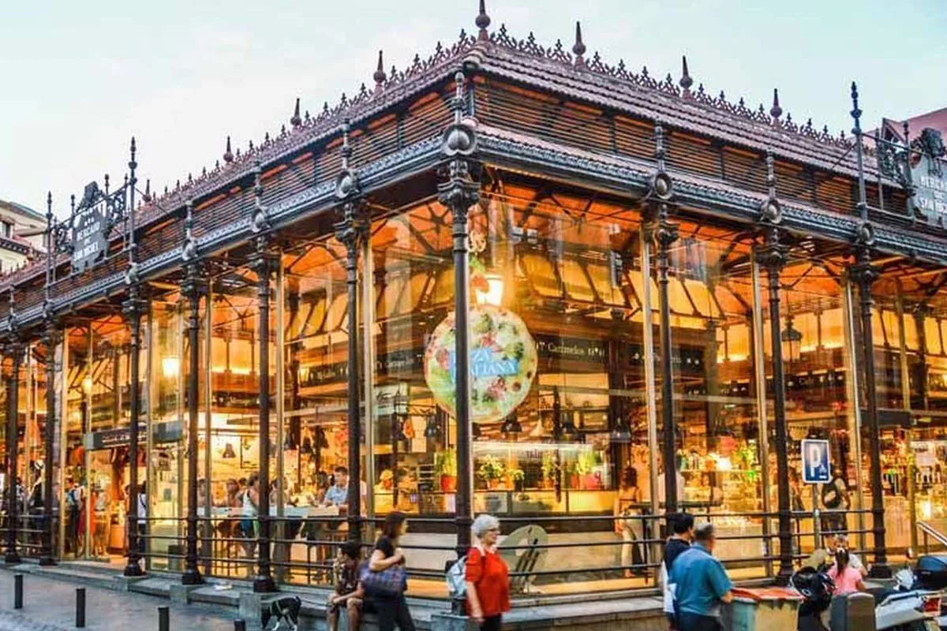
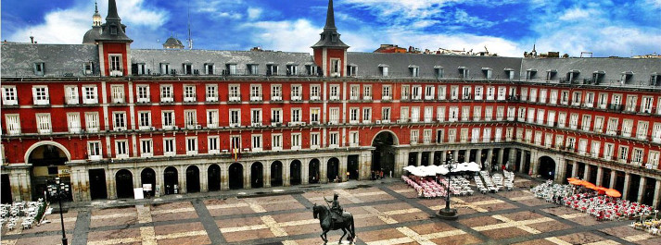
WALKING FROM PLAZA MAYOR (RIU HOTEL)

Slide 4
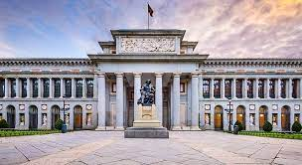


DO NOT MISS!
PRADO MUSEUM
RETIRO PARK

Slide 5

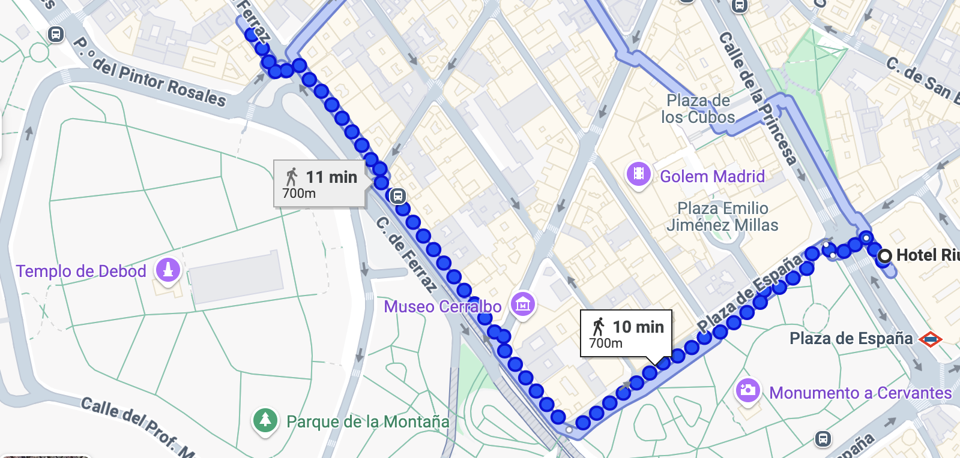
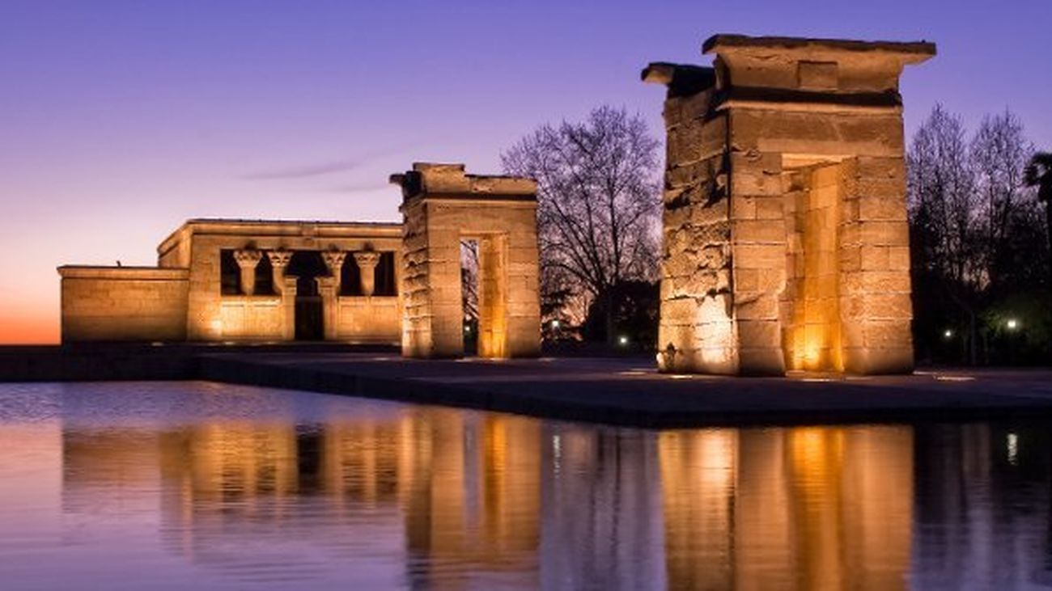
DINNER TONIGH
8pm
RESTAURANTE OLMO
C/Ferraz 5

Slide 6
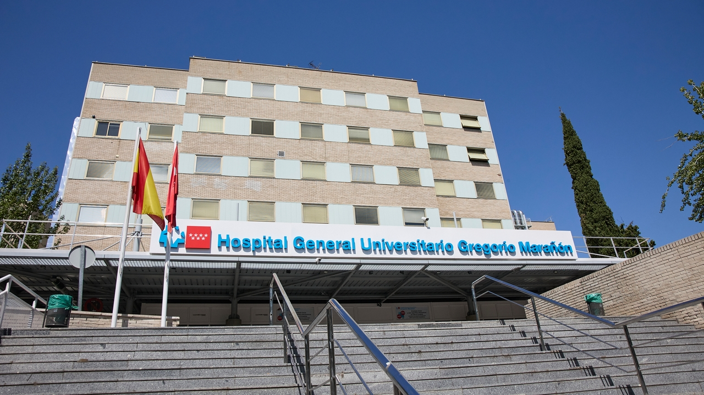
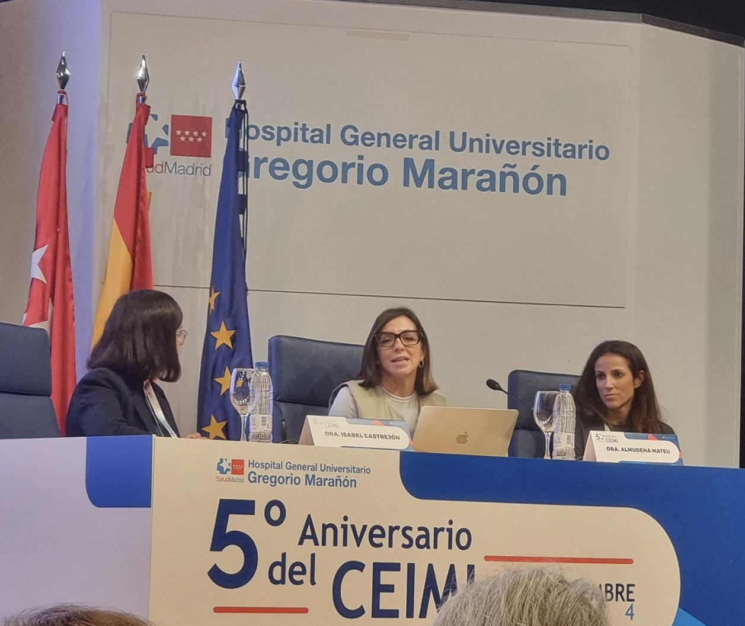



WELCOME TO MADRID AND ENJOY THE MEETING
Isabel Castrejon, MD PhD
Co-director Center for Immuno-mediated Diseases
Associate Prof. Medicine UCM
isabel.castrejon@salud.madrid.org

Slide 7
Discussion of current practice of Training in Europe

Slide 8
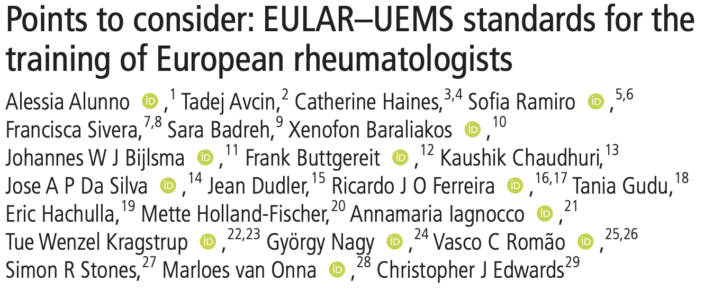
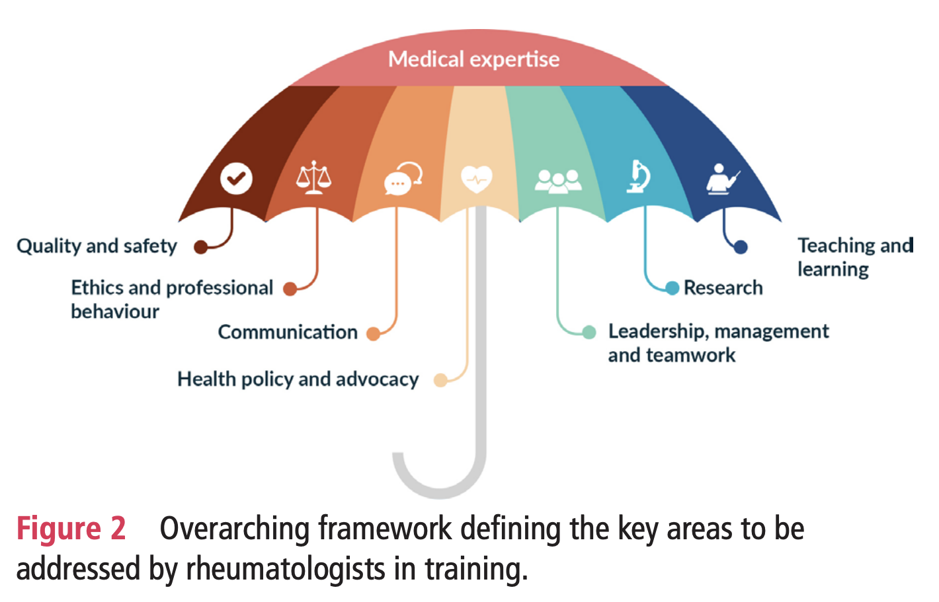
Alunno A, Avcin T, Haines C, et al. Ann Rheum Dis 2023;82:1107–1113.

Slide 9
Rheumatology Training in Europe: Situation, Challenges, and Opportunities
Understand the current landscape of rheumatology training
Identify key challenges faced by trainees in your country
Explore innovative solutions and collaborative opportunities

Slide 10
1. CURRENT SITUATION
Variability in training duration and structure - How long is the rheumatology training in your country?
Differences in curriculum and exposure (e.g., MSK ultrasound, pediatric rheumatology) - What is the balance between clinical work, theory, and research?
Recognition of rheumatology specialization across borders - Are there standardized assessments?
Role of UEMS and EULAR in standardization

Slide 11
2. KEY CHALLENGES
What are the biggest difficulties faced during training?
Is there adequate mentorship and supervision?
How is clinical and procedural competence (e.g., joint injections) assessed?
There is enough multidisciplinary interaction?
How rheumatology workforce shortages and potential burnout can impact training?

Slide 12
3. OPPORTUNITIES AND STRENGTHS
Competency-based vs. time-based training - What changes would you make to the actual curriculum in your country?
Regular feedback and portfolio systems - Are trainees fairly and regularly evaluated?
What’s one thing your country does well in training? Are multidisciplinary clinics part of your training?
What innovations have been successfully implemented in your country?
  Digital learning and simulation tools
  International fellowships and exchanges
  National society support in some countries

Slide 13
FINAL THOUGHTS
Training quality affects future care quality
Sharing ideas leads to shared progress
Moving toward a more homogeneous European curriculum with EULAR and UEMS support: reality vs dream
We need to incorporate trainee-led advocacy and feedback
Continuous dialogue is key to growth
THANK YOU FOR THE DISCUSSION!

